Slide 1
CRYPTOGRAPHY

Slide 2
CRYPTOGRAPHY
Cryptography is one of the most important components of blockchain. It plays an important part in validating users and securing transactions. Cryptography consists of many mathematical techniques that can be used to solve various issues in Blockchain.
Cryptography has been used from a long time ago for hiding information i.e. keeping the messages confidential. Cryptography has various applications like maintaining the integrity of the message, verifying and validating a user,etc.

Slide 3
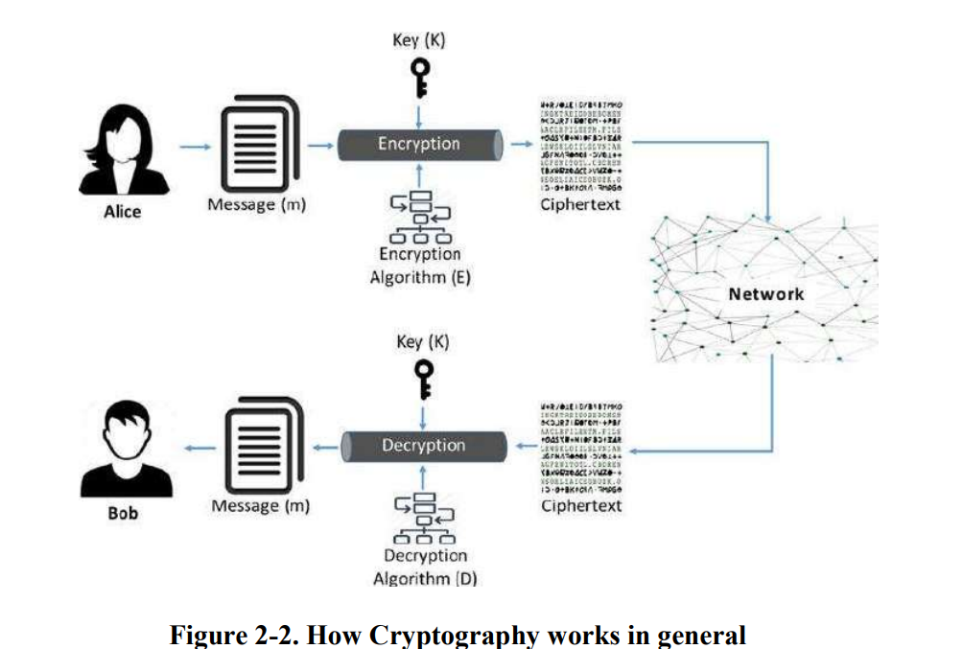

Slide 4
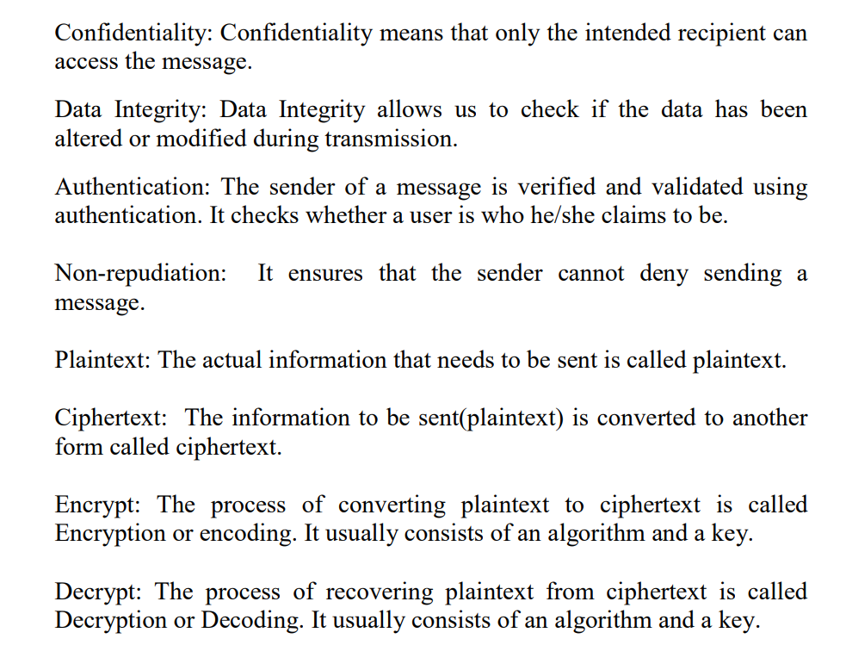

Slide 6
Please note that symmetric key cryptography exists in two variants: stream ciphers and block ciphers. We will discuss these in the following sections but we will look at Kerchoff’s principle and XOR function before that to be able to understand how the cryptosystems really work.

Slide 10
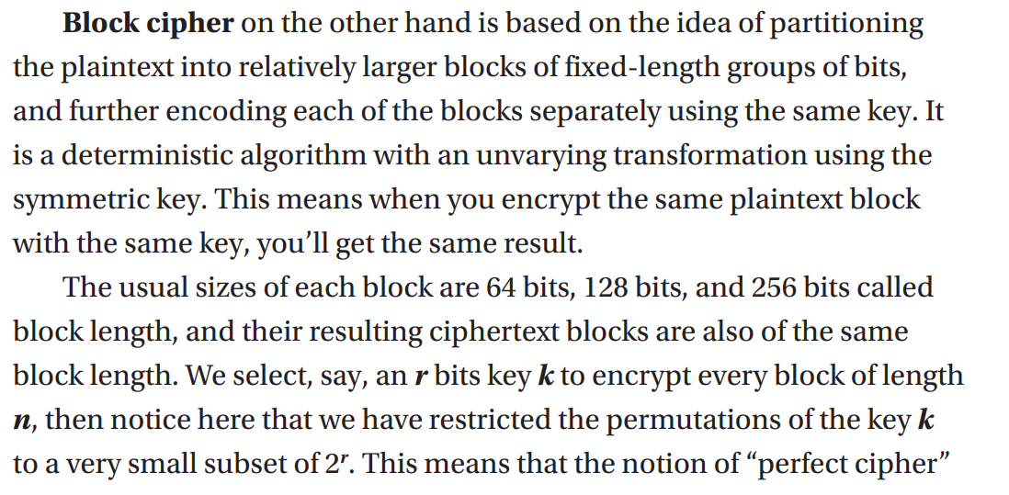

Slide 12
ASYMMETRIC KEY CRYPTOGRAPHY
Asymmetric key cryptography is also known as “public key cryptography”. Every user has a pair of keys i.e. a public key and a private key. One key is used for encryption and another for decryption. Both the keys are different. Asymmetric key cryptography can be used for confidentiality or as digital signatures. The public key can be shared with everyone but the private key is kept secret.Since, the key is public and usually stored in a public repository it is called public key cryptography.

Slide 13
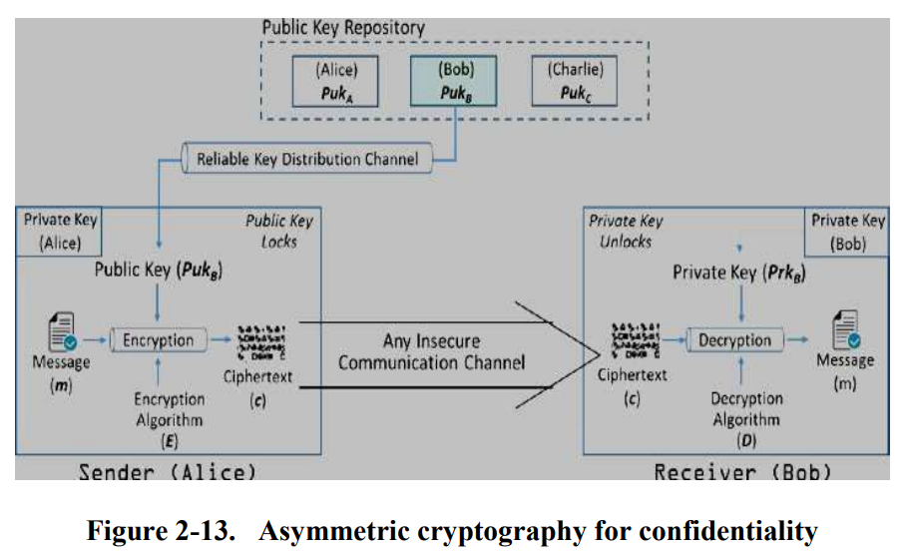

Slide 15
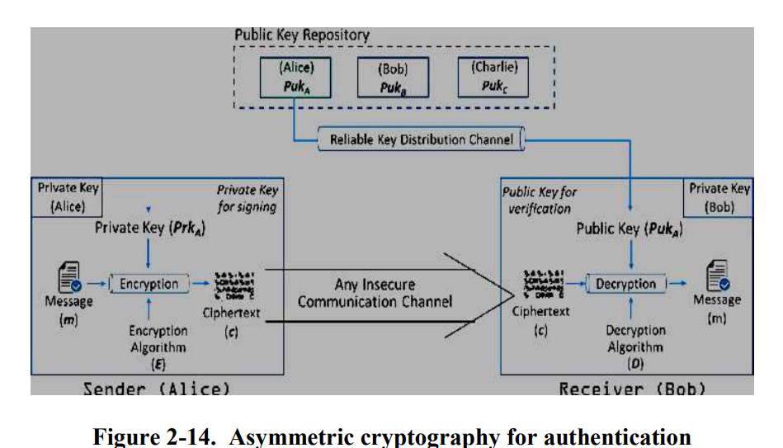

Slide 16
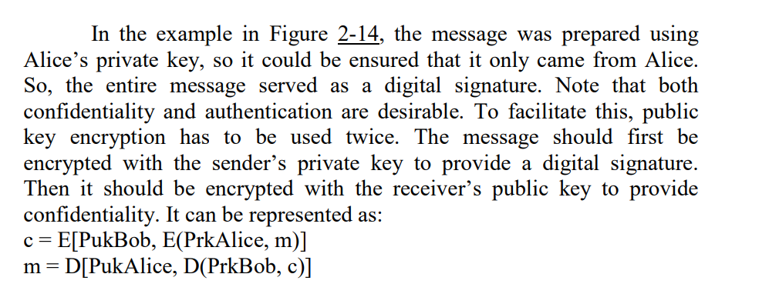

Slide 17
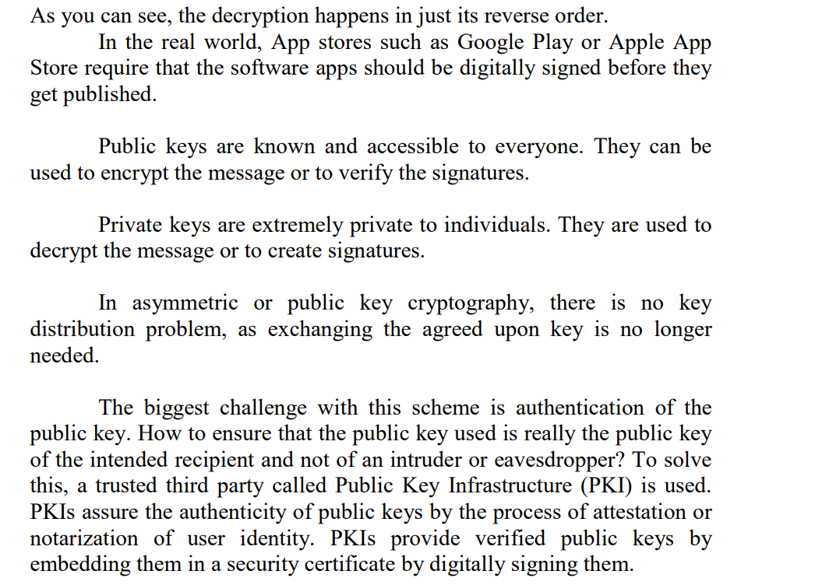

Slide 18
