Slide 1
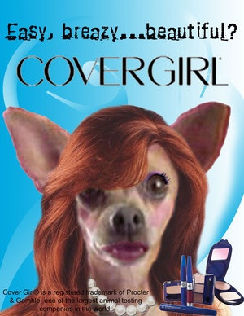
COSMETIC
ANIMAL TESTING
Beauty…. At what costs?

Slide 2
COSMETICS USED IN TESTING:
Lipstick
Eye Shadow
Eyeliner
Mascara
Foundation
Hairspray
Personal care & hygiene products are also items of the ‘cosmetic industry’

Slide 3
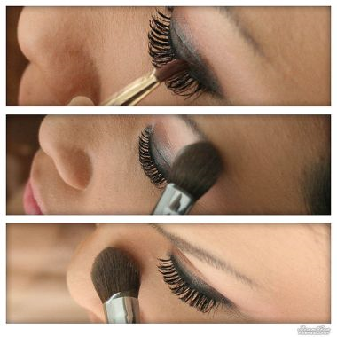

Slide 4
WHY ARE THESE PRODUCTS TESTED ON ANIMALS?
MEASURE LEVELS OF:
EYE TISSUE DAMAGE
SKIN IRRITANCY
TOXICITY
CAUSED BY NUMEROUS SUBSTANCES USED IN THE MANUFACTURE OF COSMETICS

Slide 5
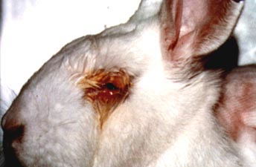
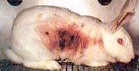
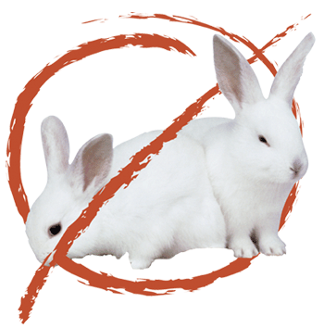
TYPES OF TESTS
Draize eye irritancy test
Draize skin irritancy test
lethal dosage (Ld) test

Slide 6
PROCEDURE
DRAIZE EYE IRRITANCY TEST:
Animal is placed in restraining stocks that hold their heads in place
eyelids are clipped open
Solutions of products are applied
DRAIZE SKIN IRRITANCY TEST:
Animal is shaved or abraded
Solutions of products are applied to raw skin
Covered with plastic sheeting
THE LETHAL DOSAGE (LD) TEST:
Animal is restrained
Solutions of products are forced through stomach tubes, vapor spray inhalers or injection

Slide 7
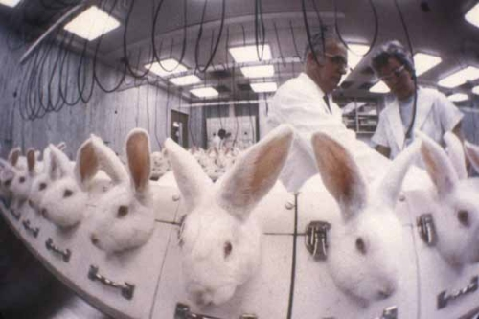

Slide 8
BENEFITS OF TESTING
may show if there are any adverse reactions to skin or eyes
may show if product is toxic
There are specific laws which delegate what is considered to be cruelty. They have fewer rules then working with humans so scientists can slightly more freely work on animals
An animals skin, body, and internal workings are similarly structured to a humans which gives the closest accurate results to what a human will experience
easier for scientists to get funding when using animal testing as opposed to human testing

Slide 9
DISADVANTAGES
Extremely painful for animals
Test are extremely expensive
Test take months or even years to conduct
All of the animals are killed once the tests are completed so that their internal organs can be examined

Slide 10
FACTS THAT YOU MAY NOT KNOW
The FDA does not require cosmetic products to be tested on animals. However, it strongly recommends that whatever tests are necessary should be carried out to ensure the safety of a cosmetics product and companies often argue that animal testing is the best way to provide the proof needed.
when you see the words "cruelty free" on a label all it means is that the company IS not currently testing the ingredients on animals, HOWEVER There is no guarantee that animal testing wasn't carried out in the past.

Slide 11
NON-ANIMAL TESTING COMPANIES
Avon Cosmetics
Clinique
Revlon
Avalon Natural Products
Jason Natural Cosmetics
Barry M Cosmetics
Kingfisher
Beauty Without Cruelty
Liz Earle
Bio-D
Meadowsweet
Daniel Field
Neal’s Yard Remedies
Faith In Nature
Urtekram
Green People
Weleda Honesty Cosmetics
Yaoh
Bath and body works
Beauty bliss cosmetics

Slide 12
ANIMAL TESTING COMPANIES
Arm & hammer
Clean and clear
clairol
nair
neutrogena
Old spice
Pantene
Johnson & johnson
oxiclean
olay
lancome
Estée Lauder
SC Johnson
FCUK
Virgin Vie
Givenchy
Jeyes
Beiersdorf
L’Oreal/Nestlé
Miners Cosmetics
Colgate
Palmolive
PZ Cussons
Coty
ves Saint Laurent
Helena Rubenstein
Unilever

Slide 13
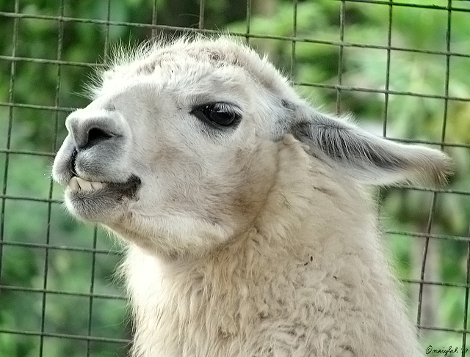
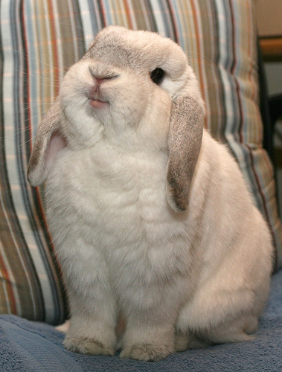
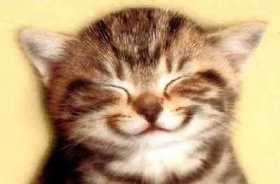
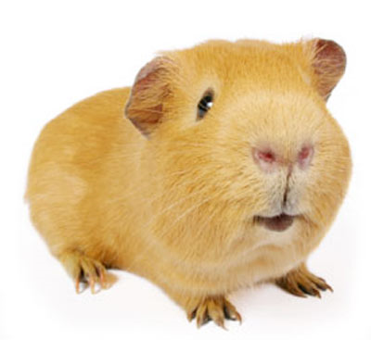
ALTERNATIVES
cell cultures
tissue cultures
corneas from the eye banks
sophisticated computer models
HET-CAM test

Slide 14
BENEFITS OF USING ALTERNATIVES
more reliable
less expensive
more consistent
better predictors for human reactions
sparing companies the expense of breeding, caging, feeding and disposing of animals that are used in testing laboratories
animals are not harmed!
http://www.youtube.com/watch?v=WXUOoZSWs9c

