Slide 1
UNIT 2
Chapter 3
Switching

Slide 2
Switching
A switched network consists of a series of interlinked nodes, called switches.
Switches are devices capable of creating temporary connections between two or more devices linked to the switch.
In a switched network, some of these nodes are connected to the end systems (computers or telephones, for example).

Slide 3
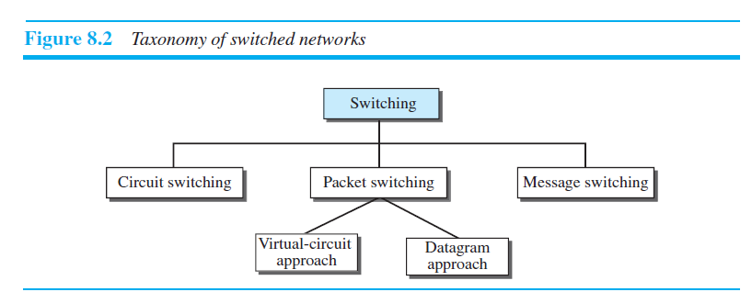
Three Methods of Switching

Slide 4
CIRCUIT-SWITCHED NETWORKS
A circuit-switched network consists of a set of switches connected by physical links.
A connection between two stations is a dedicated path made of one or more links. However, each connection uses only one dedicated channel on each link.
Each link is normally divided into n channels by using FDM or TDM.

Slide 5
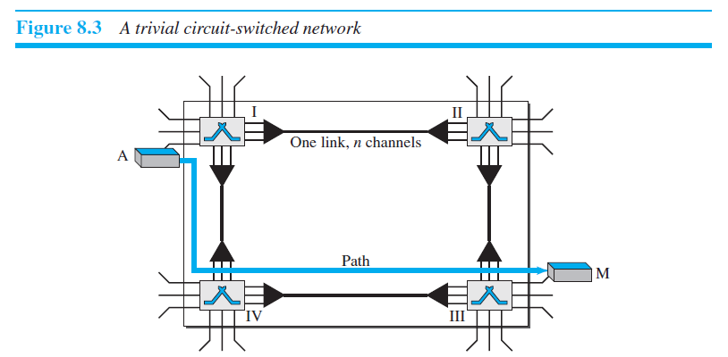

Slide 6
Three Phases
The actual communication in a circuit-switched network requires three phases: connection setup, data transfer, and connection teardown.

Slide 7
Setup Phase
Before the two parties (or multiple parties in a conference call) can communicate, a dedicated circuit (combination of channels in links) needs to be established.
The end systems are normally connected through dedicated lines to the switches, so connection setup means creating dedicated channels between the switches.

Slide 8
For example, in Figure 8.3,when system A needs to connect to system M, it sends a setup request that includes the address of system M, to switch I.
Switch I finds a channel between itself and switch IV that can be dedicated for this purpose. Switch I then sends the request to switch IV, which finds a dedicated channel between itself and switch III.
Switch III informs system M of system A’s intention at this time.
In the next step to making a connection, an acknowledgment from system M needs to be sent in the opposite direction to system A.
Only after system A receives this acknowledgment is the connection established.

Slide 9
Data-Transfer Phase
After the establishment of the dedicated circuit (channels), the two parties can transfer data.
Teardown Phase
When one of the parties needs to disconnect, a signal is sent to each switch to release the resources.

Slide 10
PACKET SWITCHING
In data communications, we need to send messages from one end system to another.
If the message is going to pass through a packet-switched network, it needs to be divided into packets of fixed or variable size.
The size of the packet is determined by the network and the governing protocol.
In a packet-switched network, there is no resource reservation;resources are allocated on demand.

Slide 11
Datagram Networks
In a datagram network, each packet is treated independently of all others.
Even if a packet is part of a multipacket transmission, the network treats it as though it existed alone.
Packets in this approach are referred to as datagrams.
Datagram switching is normally done at the network layer.

Slide 12
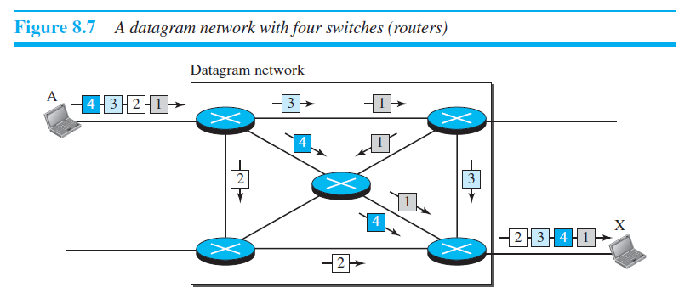

Slide 14
Routing Table
If there are no setup or teardown phases, how are the packets routed to their destinations in a datagram network?
In this type of network, each switch (or packet switch) has a routing table which is based on the destination address.
The routing tables are dynamic and are updated periodically.
The destination addresses and the corresponding forwarding output ports are recorded in the tables.
This is different from the table of a circuit switched network in which each entry is created when the setup phase is completed and deleted when the teardown phase is over.

Slide 15
Destination Address
The destination address in the header of a packet in a datagram network remains the same during the entire journey of the packet.

Slide 16
Virtual-Circuit Networks
A virtual-circuit network is a cross between a circuit-switched network and a datagram network.
It has some characteristics of both.
1. As in a circuit-switched network, there are setup and teardown phases in addition to the data transfer phase.
2. Resources can be allocated during the setup phase, as in a circuit-switched network, or on demand, as in a datagram network.
3. As in a datagram network, data are packetized and each packet carries an address in the header.
4. As in a circuit-switched network, all packets follow the same path established during the connection.
5. A virtual-circuit network is normally implemented in the data-link layer, while a circuit-switched network is implemented in the physical layer and a datagram network in the network layer.

Slide 17
Addressing
In a virtual-circuit network, two types of addressing are involved: global and local (virtual-circuit identifier).
Global Addressing
A source or a destination needs to have a global address—an address that can be unique in the scope of the network or internationally if the network is part of an international network.

Slide 18
Virtual-Circuit Identifier
The identifier that is actually used for data transfer is called the virtual-circuit identifier (VCI) or the label.
A VCI, unlike a global address, is a small number that has only switch scope; it is used by a frame between two switches.
When a frame arrives at a switch, it has a VCI; when it leaves, it has a different VCI.

Slide 20
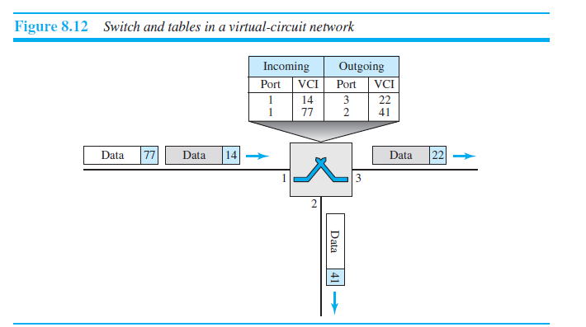
Three Phases of VC network: Data-Transfer Phase

Slide 21
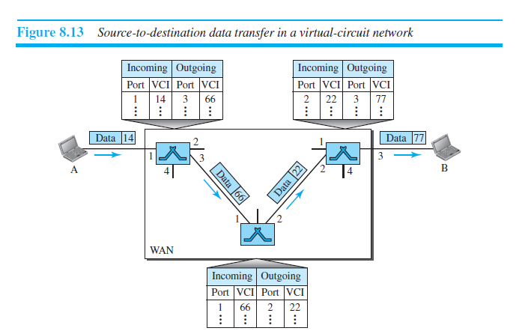

Slide 22
Setup Phase
In the setup phase, a switch creates an entry for a virtual circuit.
For example, suppose source A needs to create a virtual circuit to B.
Two steps are required: the setup request
and the acknowledgment.

Slide 23
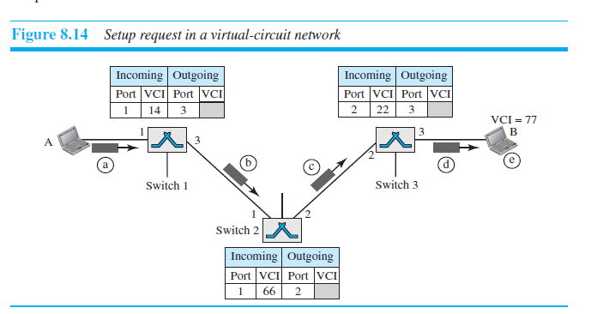
Setup Request

Slide 24
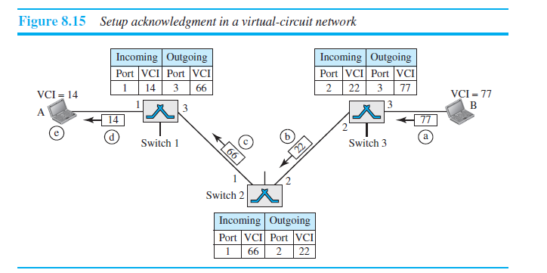
Acknowledgment

Slide 25
Teardown Phase

