Slide 1
Pre-raphaelitism
Dr. Lakshmi Muthukumar,
Head, Department of English
SIES College of arts, science and commerce (autonomous), sion west

Slide 2
Introduction
Opposed victorianism
Pre-raphaelitism was aesthetic In nature and was an attempt to revive the spirit of the romantic revival movement
It was inspired by the Oxford movement

Slide 3
Causes
Was originally a painters’ movement started in 1848
Victorian art showed absence of inspiration, the cause of pre-raphaelitism was a protest against painters like sir Joshua Reynolds who followed the grand style of 18th century academics of art
Ruskin`s book "modern poetry"
The English painters
They called themselves pre-raphaelites to emphasize their allegiance
They identified with early Italian poets whose art was realistic and passionate

Slide 4
characteristics
Attention to realistic detail
Returned to the nature
Elaborate care in painting pictures
The use of symbolism
Acquired from Italian poets
Rossetti`s "Girlhood of Mary Virgin"
Realists as well as medievalists

Slide 5
Characteristics
Pre-raphaelites turned to Keats
They opposed Arnold`S view of poetry
They wrote for the sake of poetry
Differed from other Victorian poets

Slide 6
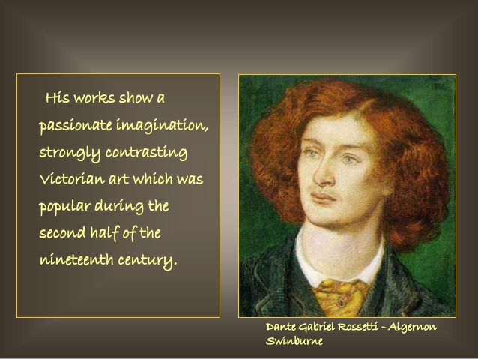
d.g.Rossetti
Dominant personality, poetry pure art
The Blessed Damozel- chief qualities of the pre-raphaelite school evident in his work
Closer to Keats than to Browning
Poetry perceived as a creation of beauty - picturesque, sensual and suggestive

Slide 7
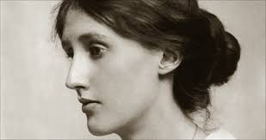
Christina Rossetti

Slide 8
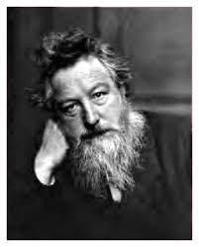
William Morris

Slide 9
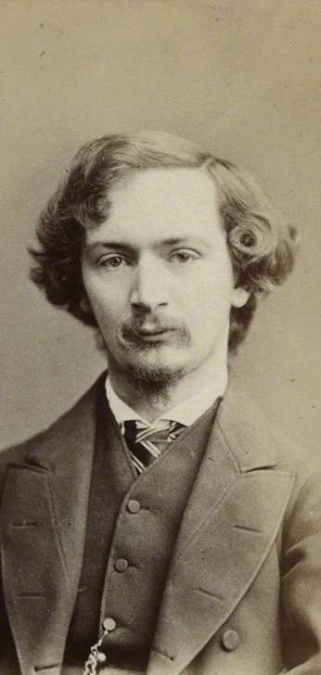
a.c.Swinburne

Slide 10
Thank you!

