Slide 1
CARBOHYDRATES
F.Y.B.Sc, PAPER II UNIT 1

Slide 2
INTRODUCTION
Abundant class of biomolecules
Saccharides
ORGANISM | WATER | CARBO HYDRATE | PROTEIN | LIPID | ASH
PLANT | 60 | 30 | 5 | 1 | 4
ANIMAL | 60 | 1 | 20 | 15 | 4

Slide 3
NOMENCLATURE
HYDRATES OF CARBON
C_{X}(H₂0)_{Y}
Deoxyribose C₅H₁₀0₄
Rhamnose C₆H₁₂0₅
Glucosamine C₆H₁₃0₅ N

Slide 4
NOMENCLATURE
Formaldehyde CH₂0
Acetic acid C₂H₂0₄
Lactic acid C₃H₆0₃
Polyhydroxy aldehyde or Polyhydroxy ketones, derivatives or substances that yield one of these compounds on hydrolysis.

Slide 5
CLASSIFICATION
CARBOHYDRATES
MONOSACCHARIDE
OLIGOSACCHARIDE
POLYSACCHARIDE

Slide 6
MONOSACCHARIDE
Mono= one, saccharon= sugars
Simple sugars
Free aldehyde group (-CHO)
Ketone group (=CO)
2 or more hydroxyl group, C_{n}H₂0_{n}

Slide 7
MONOSACCHARIDE
 | FORMULA | ALDOSES (ALDO SUGAR) | KETOSES (KETO SUGAR)
TRIOSES | C₃H₆0₃ | GLYCEROSE | DIHYDROXY ACETONE
TETROSES | C₄H₈0₄ | ERYTHROSE | ERYTHRULOSE
PENTOSES | C₅H₁₀0₅ | RIBOSE | RIBULOSE
HEXOSES | C₆H₁₂0₆ | GLUCOSE | FRUCTOSE
HEPTOSES | C₇H₁₄0₇ | GLUCOHEPTOSE | SODOHEPTULOSE

Slide 8
MONOSACCHARIDE
Glycerose Aldotriose
Ribulose Ketopentose
Glucose Aldohexose
Aldoses suffix oses
Ketoses suffix uloses

Slide 9
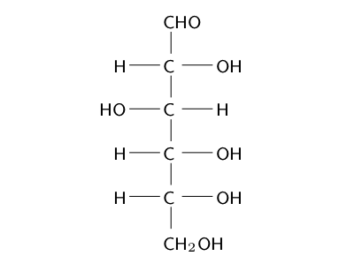
GLUCOSE

Slide 10
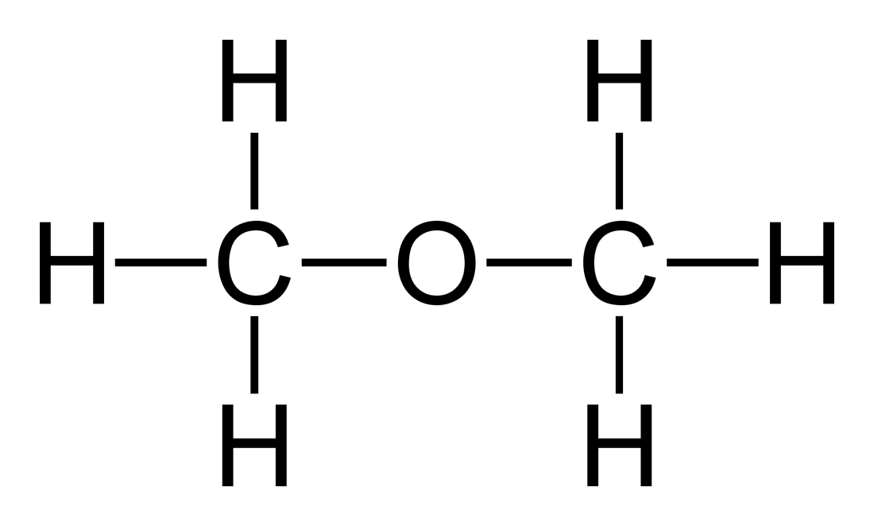
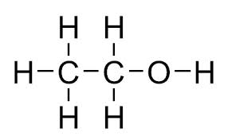
isomerism
ETHYL ALCOHOL
DIMETHYL ETHER

Slide 11
ISOMERISM
ISOMERISM
STRUCTURAL
ISOMERISM
STEREOISOMERISM
CHAIN
POSITIONAL
FUNCTIONAL
GROUP
GEOMETRICAL
OPTICAL

Slide 12
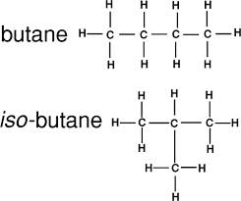
CHAIN ISOMERISM

Slide 13
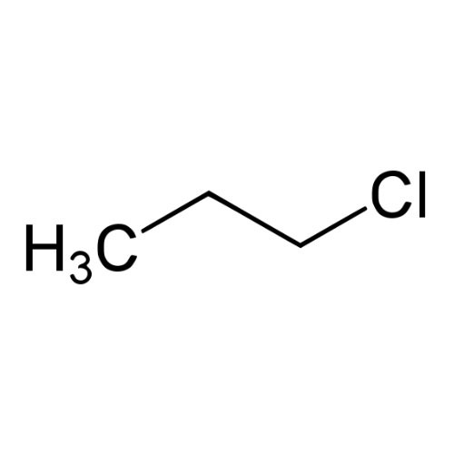
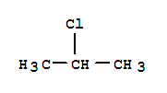
POSITIONAL ISOMERISM
ISO PROPYL CHLORIDE
N PROPYL CHLORIDE

Slide 14
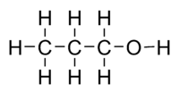
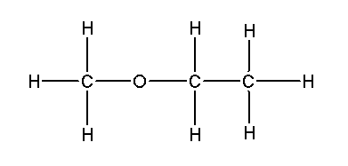
FUNCTIONAL GROUP
n PROPANOL
ETHYL METHYL ETHER

Slide 15
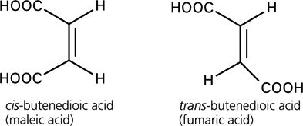
GEOMETRICAL ISOMERISM

Slide 16
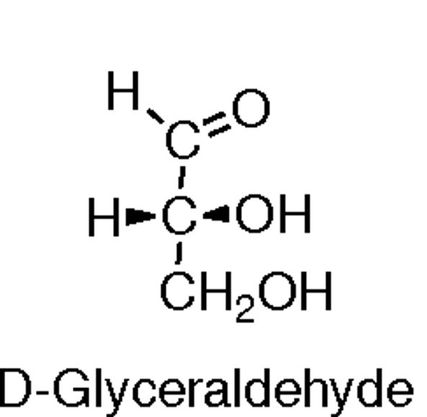
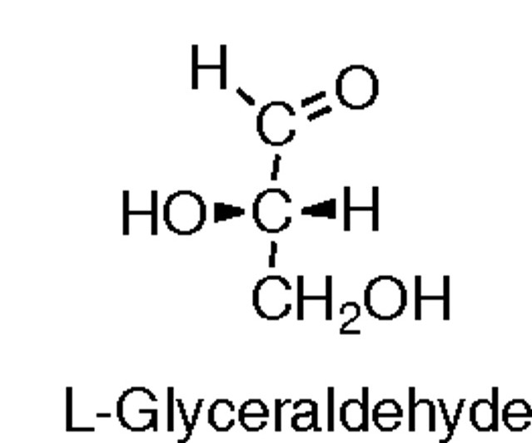
OPTICAL ISOMERS

Slide 17
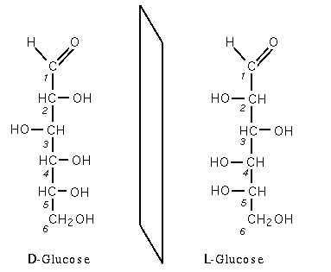
OPTICAL ISOMERS

Slide 18
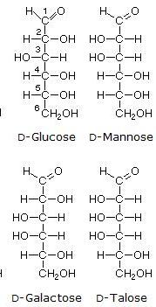
HEXOSES

Slide 19
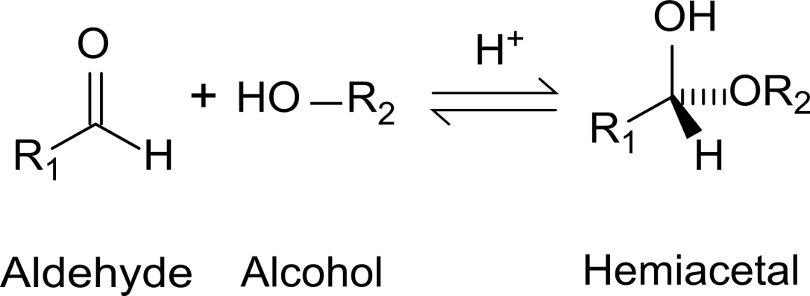
FORMATION OF alpha and beta D glucose

Slide 20
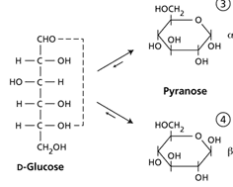
Formation of α and β D glucose

Slide 21
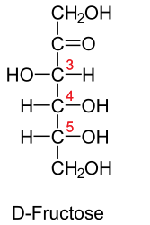
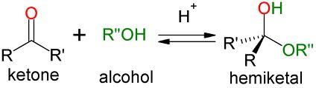
Formation of alpha & beta d Fructose.

Slide 22
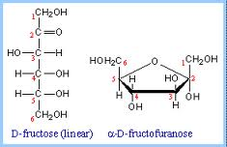
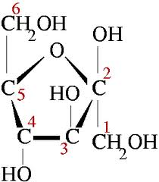
Formation of α and β D fructose

Slide 23
OLIGOSACCHARIDE
DISACCHARIDE: SUCROSE, LACTOSE, MALTOSE
TRISACCHARIDE: RAFFINOSE, MALTOTRIOSE
TETRASACCHARIDE: STACHYOSE

Slide 24
disaccharide
DISACCHARIDE
NON
REDUCING
C1→C1/C2
GLYCOSIDIC LINKAGE
REDUCING
C1→C4/C6
GLYCOSIDIC LINKAGE

Slide 25
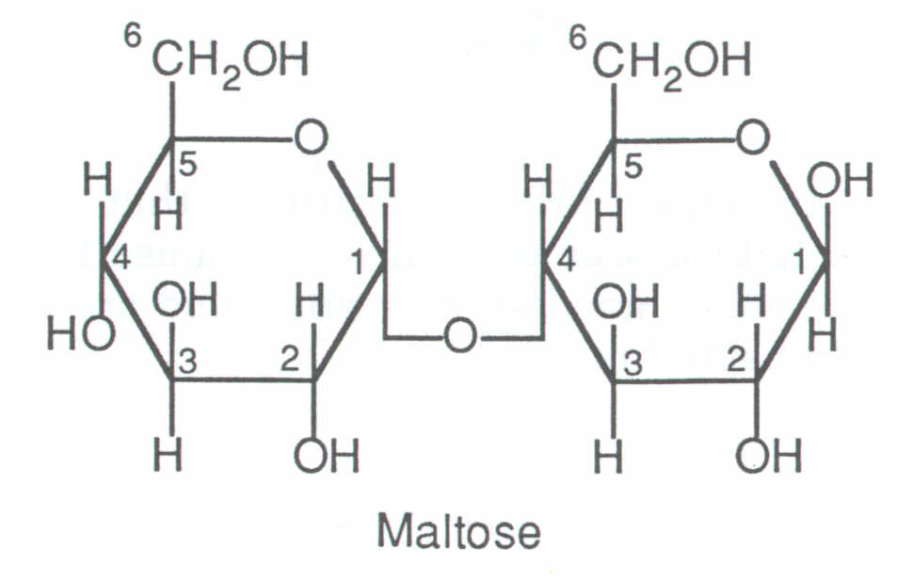
MALTOSE
Two α D-Glucose
α 1,4 glycosidic linkage.

Slide 26
SUCROSE
Common sugar.
Plant origin.
α 1, 2 glycosidic linkage.
Non reducing sugar.

Slide 27
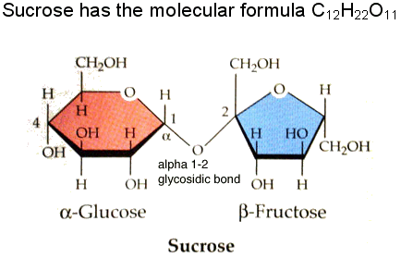

Slide 28
LACTOSE
Milk sugar.
Animal origin.
Β1,4 galactoside.
Reducing sugar.

Slide 29
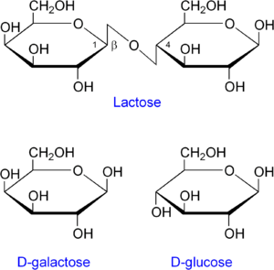
LACTOSE

Slide 30
POLYSACCHARIDE
POLYSACCHARIDE
HOMOPOLYSACCHARIDE
HETEROPOLYSACCHARIDE

Slide 31
POLYSACCHARIDE
POLYSACCHARIDE
NUTRITIVE POLYSACCHARIDE
NON NUTRITIVE
POLYSACCHARIDE

Slide 32
starch
STARCH
AMYLOSE
250-1000s
AMYLOPECTIN
30

Slide 33
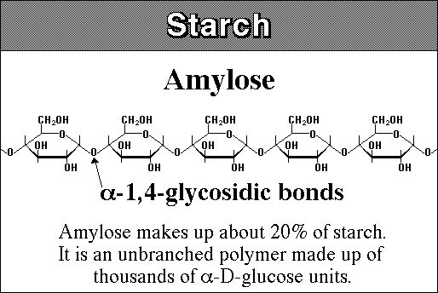

Slide 34
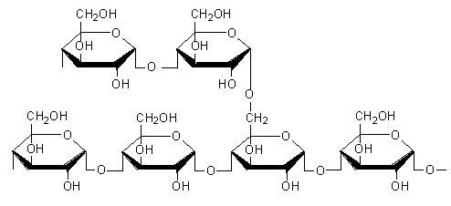
amylopectin

Slide 35
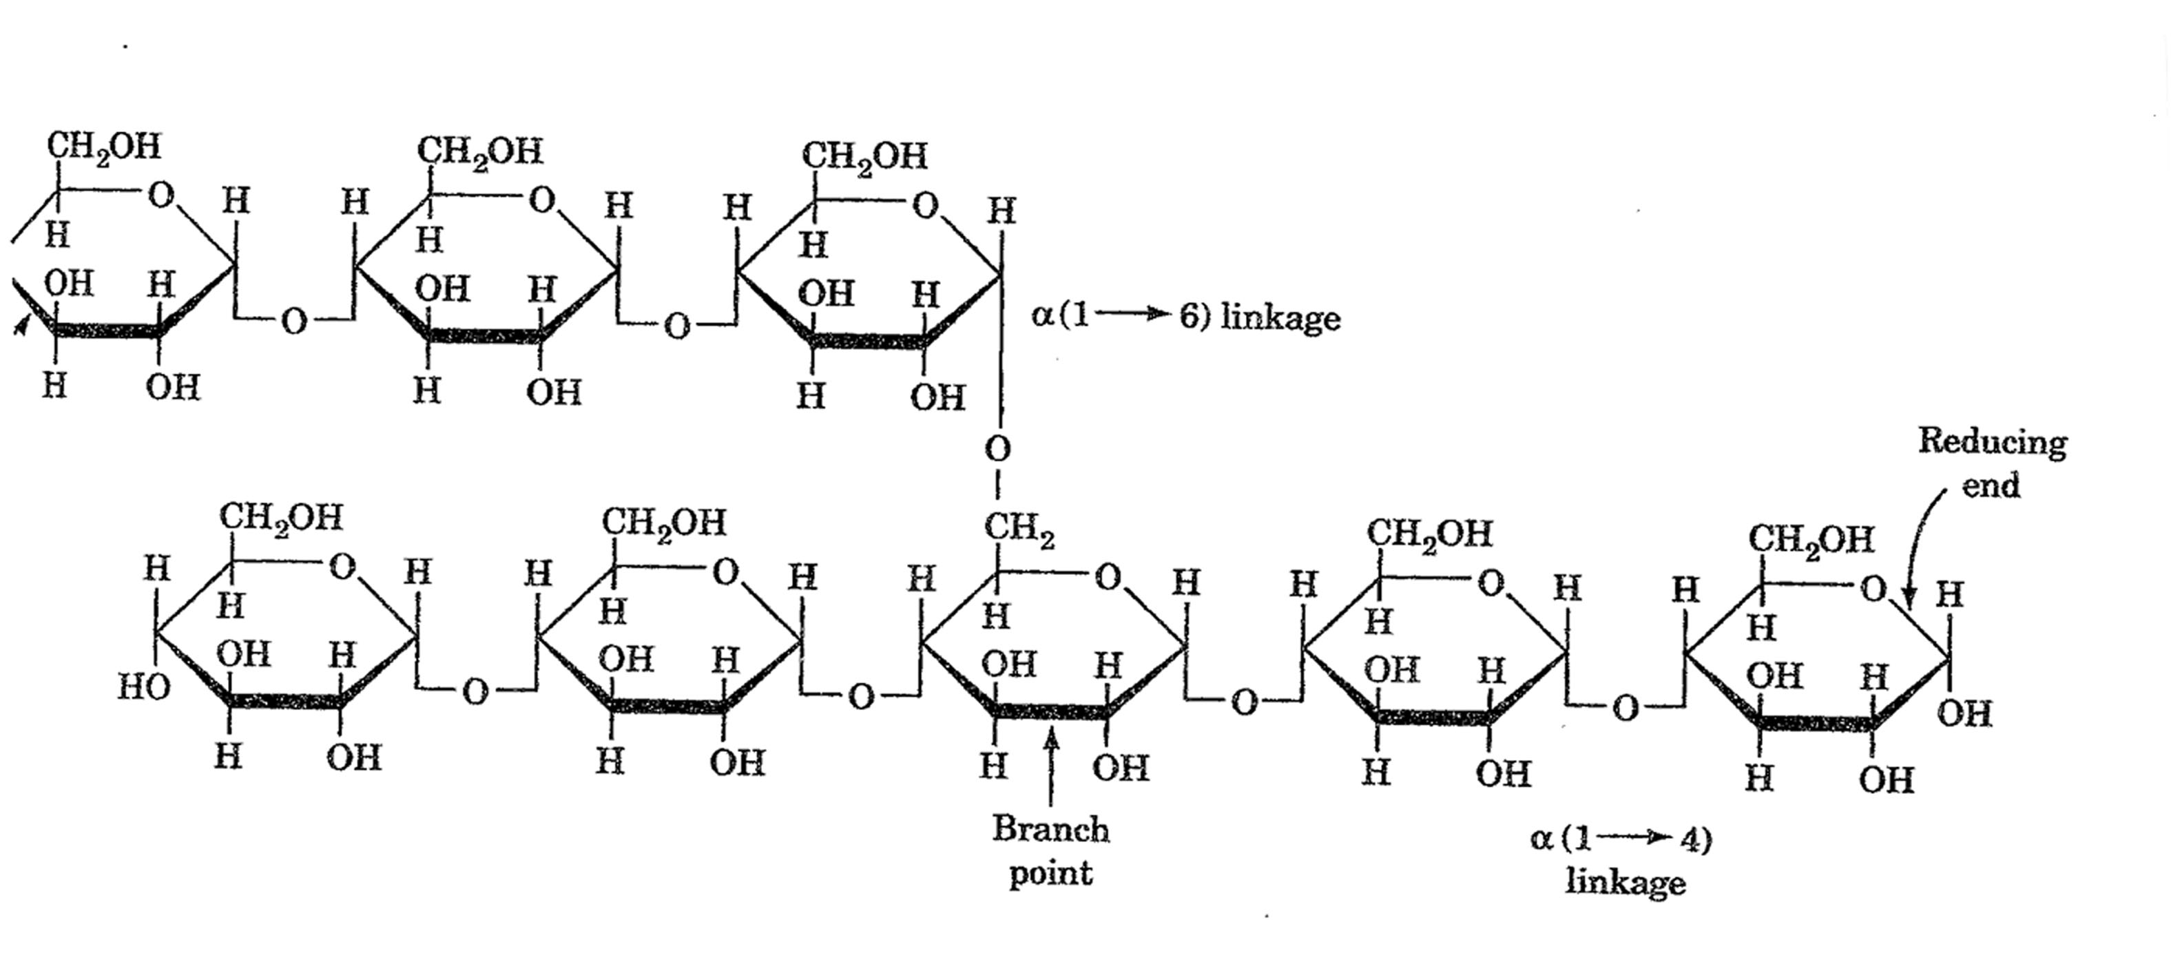
GLYCOGEN

Slide 36
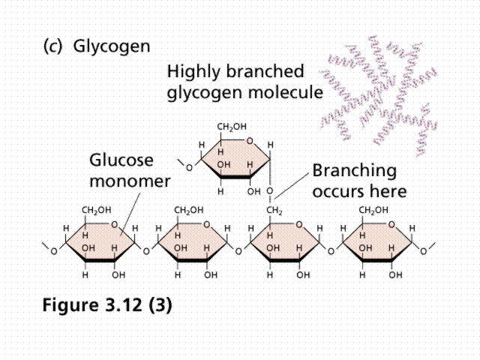

Slide 37
HEPARIN
N ACETYL
GLUCOSE
AMINE
GLUCURONIC ACID
HEPARIN

Slide 38
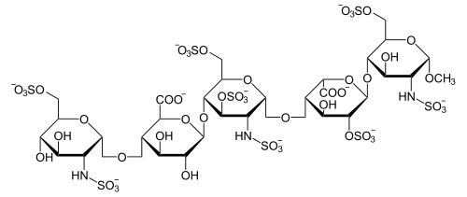
HEPARIN

Slide 39
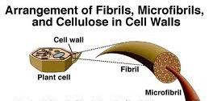
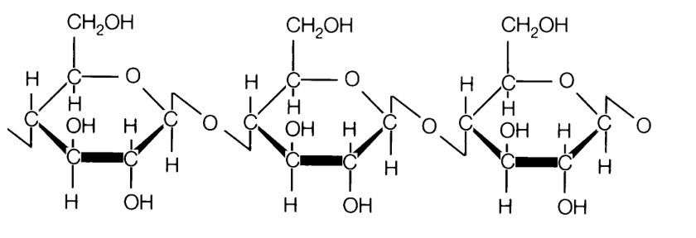

Slide 40
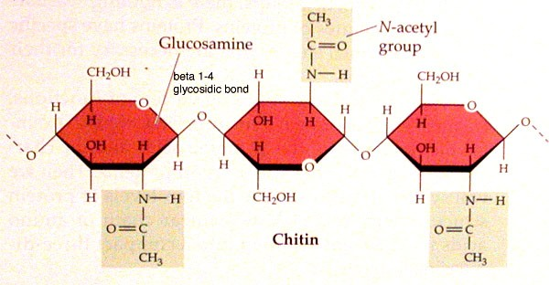
CHITIN

Slide 41
BIOLOGICAL ROLE OF CARBOHYDRATES
CARBOHYDRATE AS MAJOR NUTRIENT AND AS STORAGE FORM OF CELL FUEL
GLUCOSE
STARCH
GLYCOGEN

Slide 42
BIOLOGICAL ROLE OF CARBOHYDRATES
CARBOHYDRATES AS STRUCTURAL COMPONENTS.
HEPARIN
COENZYMES----NIACIN, NICOTINAMIDE
VITAMIN C (ASCORBIC ACID)
ANTIFREEZE PROTEIN

Slide 43
BIOLOGICAL ROLE OF CARBOHYDRATES
PROTECTIVE FUNCTION
CELLULOSE
CHITIN
MUCOPOLYSACCHARIDE

Slide 44
Reactions of monosaccharides
BENEDICTS TEST
MOLISCH TEST
REDUCING SUGARS

