Slide 1
MOLECULAR BASIS OF LIFE
FYBSC PAPER 2 UNIT 2

Slide 4
SYLLABUS
1.1: Biological micro- and macro-molecules
Monomeric constituents, polymers and significance of carbon

Slide 5
SYLLABUS
1.2: Proteins
1.2.1: Amino acids: Types based on carboxylic, amino and aromatic group.
1.2.2: Peptide bond
1.2.3: Structure of proteins: Primary, secondary, tertiary, and quaternary structure.
1.2.4: Biological role of proteins.

Slide 6
SYLLABUS
1.3: Carbohydrates
1.3.1: Nomenclature, isomerism and classification.
1.3.2: Glycosidic bond
1.3.3: Types of carbohydrates:
Monosaccharides: Glucose, fructose, galactose
Disaccharides: Maltose, sucrose, lactose
Polysaccharides: Starch, glycogen, cellulose, chitin, heparin
1.3.4: Biological role of carbohydrates

Slide 7
BIOMOLECULES

Slide 8
What is Life?????

Slide 9
Life is a cumulative product of interactions among many types of chemical substances that make up the cells living organism

Slide 10
Chemical substances are combination of one or two elements in fixed ratio

Slide 11
COMMONLY OCCURING NATURAL ELEMENTS ESSENTIAL FOR LIFE
 | ELEMENTS | TOTAL PERCENTAGE IN LIVING BODY
COMMON ELEMENTS | CARBON | 96%
 | OXYGEN
 | HYDROGEN
 | NITROGEN
LESS COMMON ELEMENTS | PHOSPHORUS | 4%
 | SULPHUR
 | CALCIUM
 | POTASSIUM
 | SODIUM
 | MAGNESSIUM
 | CHLORINE

Slide 12
ELEMENTS
↓
ATOMS
↓
MOLECULES
↓
CHEMICALS BONDS→IONIC BOND
↓
COVALENT BOND

Slide 13
BIOLOGICAL MOLECULES
Molecules that are present in living organisms
Carbondioxide
Water
Protein

Slide 14
COMPOSITION OF CELL

Slide 15
MONOMERS
Building blocks of polymers
Repeating units
MONOMER | POLYMERS
AMINO ACIDS | PROTEINS
MONOSACCHARIDES | POLYSACCHARIDES
FATTY ACIDS & GLYCEROL | LIPIDS
ORGANIC BASES, MONOSACCHARIDES NUCLEOTIDES | NUCLEIC ACIDS

Slide 16
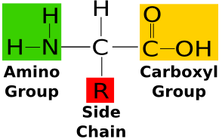
AMINO ACID

Slide 17
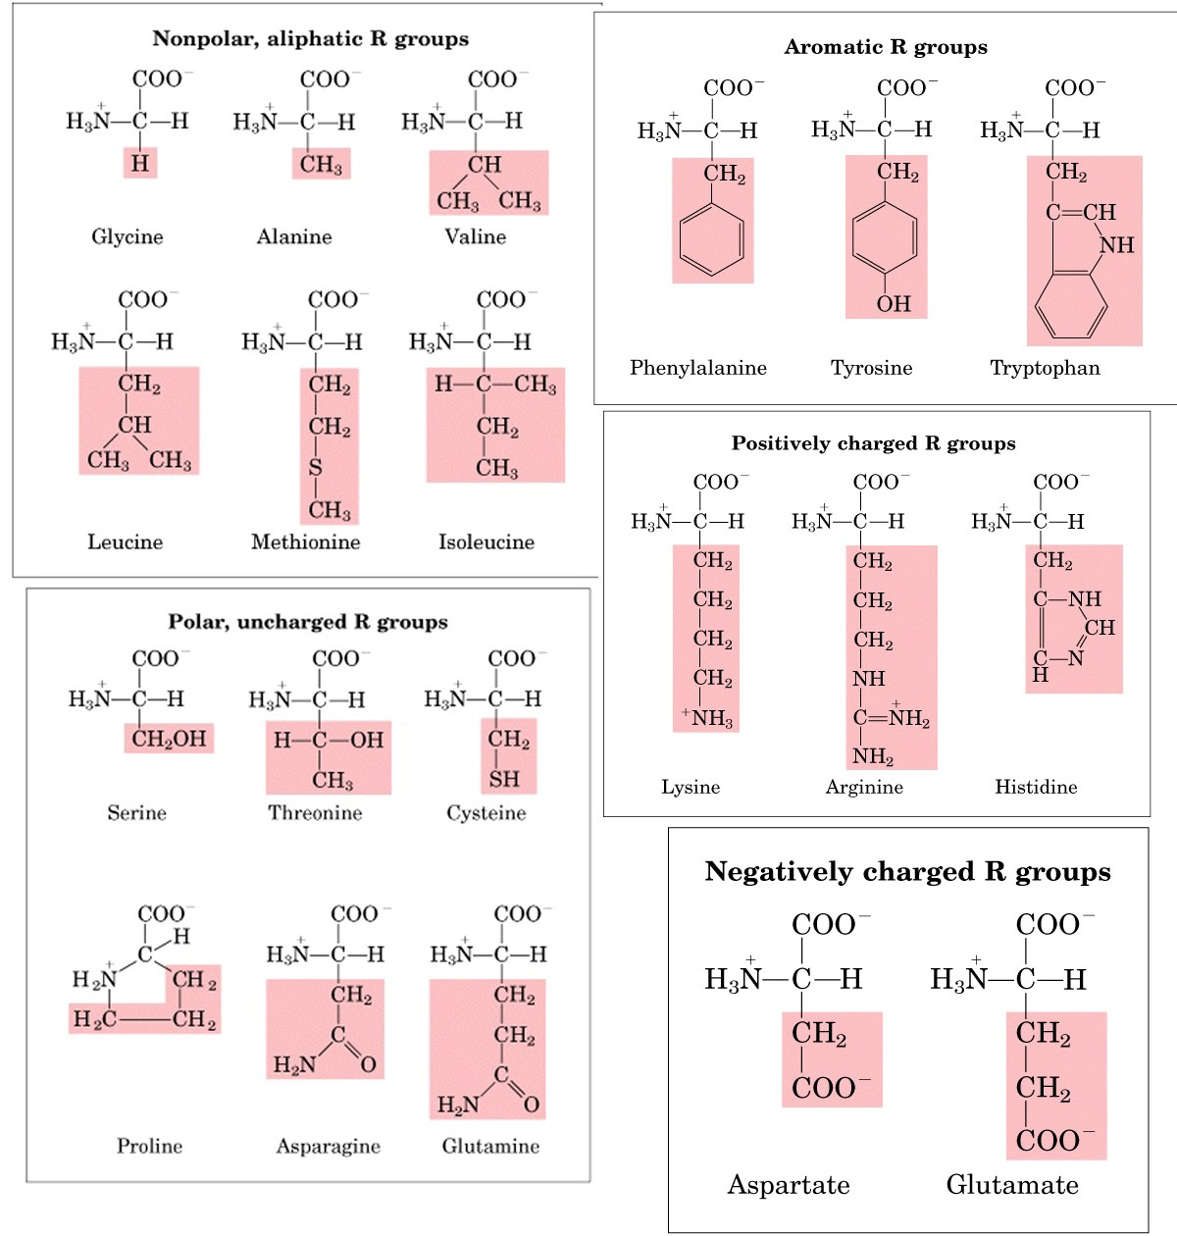

Slide 18
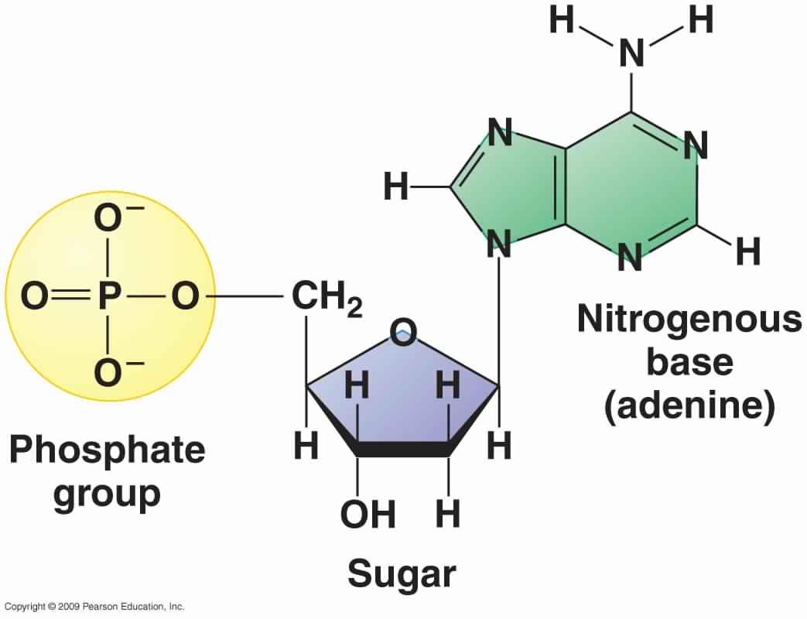
NUCLEOTIDE

Slide 19
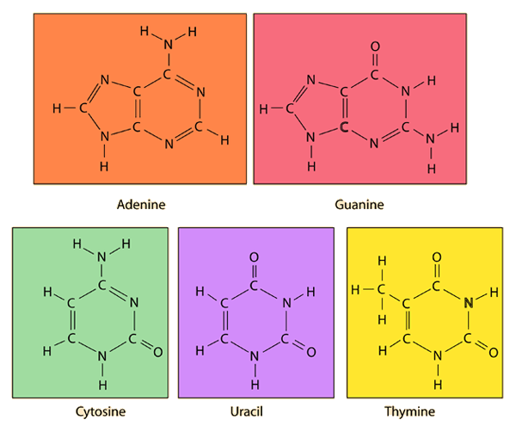
NITROGENOUS BASES

Slide 20
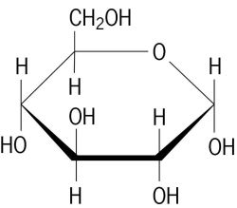
STRUCTURE OF D-GLUCOSE

Slide 21
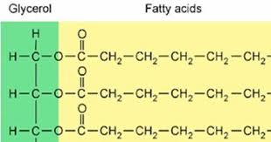
MONOMERS OF LIPIDS

Slide 22
FUNCTIONS OF MONOMERS
AMINO ACIDS
PROTEINS
PEPTIDE HORMONES
NEUROTRANSMITERS
ALKALOIDS

Slide 23
FUNCTIONS OF MONOMERS
ADENINE
NEUCLEIC ACID
ATP
COENZYMES
URIC ACID

Slide 24
FUNCTIONS OF MONOMER
GLUCOSE
STARCH
CELLULOSE
FRUCTOSE
MANNOSE
SUCROSE
LACTOSE

Slide 25
FUNCTION OF MONOMER
PALMITIC ACID
FATS
PHOSPHOLIPIDS
WAXES

Slide 26
POLYMERS
GIANT MOLECULES
MACRO MOLECULES
PROTEINS
POLYSACCHARIDES
LIPIDS
NUCLEIC ACIDS

Slide 27
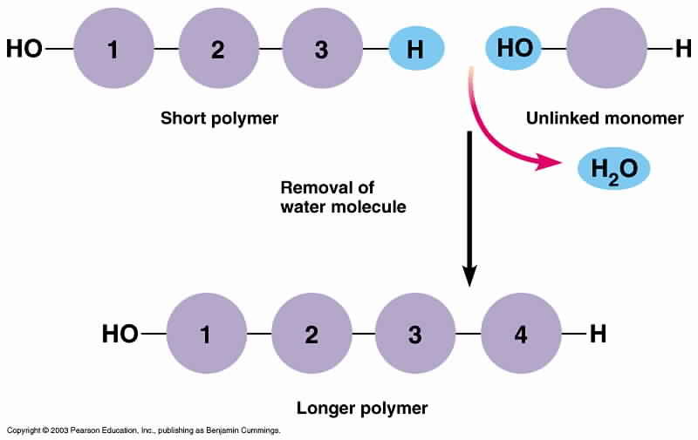
DEHYDRATION SYNTHESIS/ CONDENSATION REACTION

Slide 28
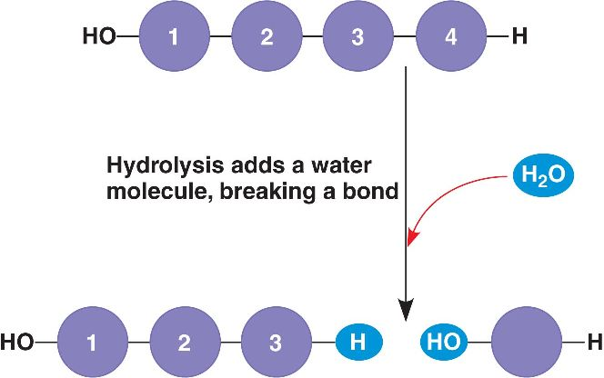
HYDROLYSIS REACTION

Slide 29
SIGNIFICANCE OF CARBON IN LIVING ORGANISM
Compounds containing carbon are organic
Chemical behavior which makes it exceptionally versatile as a building block molecular architecture
Functional groups

Slide 30
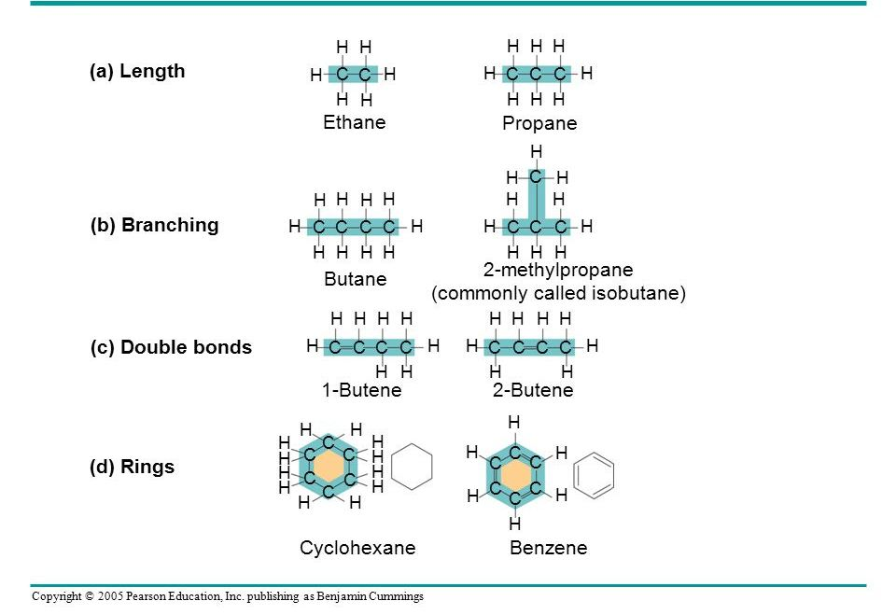
VARIATION IN CARBON SKELETON

Slide 31
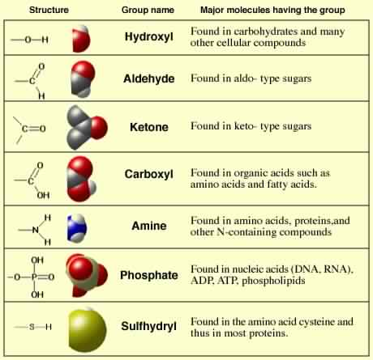

Slide 32
PROTEINS
Primary or Holding first place.
Macromolecules
C, H, O, N, S and P

Slide 33
PROTEINS
PROTEINS
SIMPLE
PROTEINS
CONJUGATE
PROTEINS
GLOBULIN
GLYCOPROTEIN

Slide 34
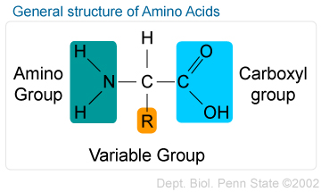

Slide 35
AMINO ACIDS
CLASSIFICATION
STRUCTURE
POLARITY
NUTRITIONAL REQUIREMENT

Slide 36
CLASSIFICATION BASED OF STRUCTURE
AMINO ACIDS
ALIPHATIC
AMINO ACIDS
CYCLIC AMINO ACIDS

Slide 37
ALIPHATIC AMINO ACIDS
SIMPLE AMINO ACIDS
HYDROXY AMINO ACIDS
SULPHUR CONTAINIG AMINO ACIDS
DICARBOXYLIC AMINO ACID
BASIC AMINO ACID

Slide 38
CYCLIC AMINO ACIDS
AROMATIC AMINO ACIDS
HETEROCYCLIC AMINO ACIDS

Slide 39
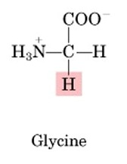
SIMPLE AMINO ACIDS
Conditionally essential amino acid

Slide 40
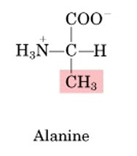
SIMPLE AMINO ACIDS
Non Essential amino acid

Slide 41
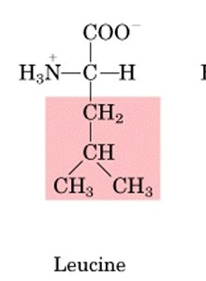
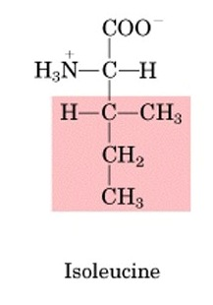
SIMPLE AMINO ACIDS
Essential amino acid

Slide 42
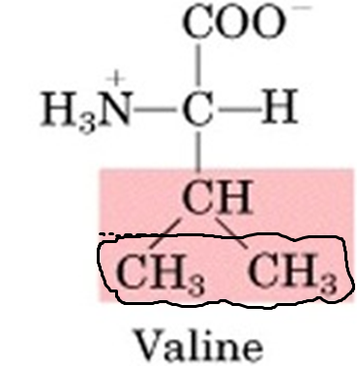
SIMPLE AMINO ACIDS
Essential amino acid

Slide 43
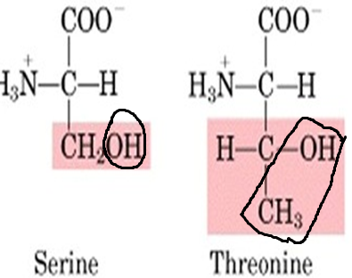
HYDROXY AMINO ACID
Serine is a conditional amino acid
Threonine is an essential amino acid

Slide 44
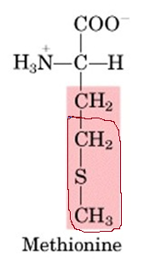
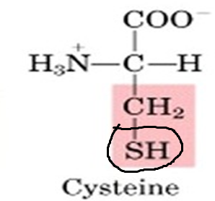
SULPHUR CONTAINING AMINO ACIDS
Essential amino acid
Condtitonal amino acid

Slide 45
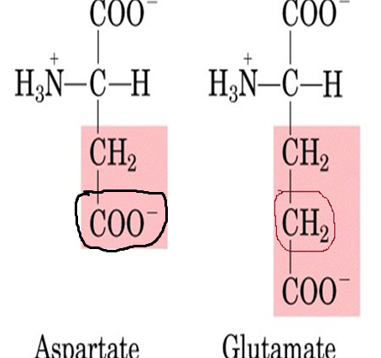
DICARBOXYLIC AMINO ACIDS
Glutamate is conditional amino acid
Aspartate is non essential amino acid

Slide 46
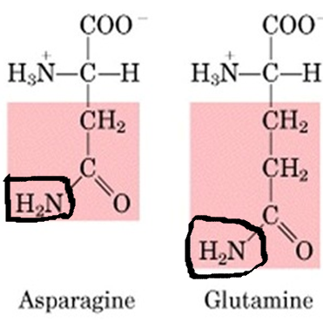
DICARBOXYLIC AMINO ACIDS
Non essential amino acids
Notes:
61% of skeletal muscles contain glutamine, Aspargine and glutamine are amides of aspartate and glutamate

Slide 47
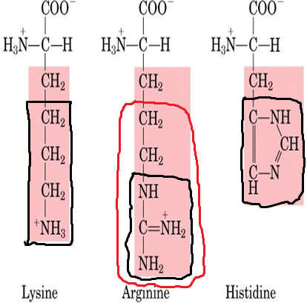
BASIC AMINO ACID
Lysine and Histidine are essential amino acids
Arginine is non essential amino acid
Imidazole ring
Guanidinium
Notes:
Ureogenesis, Arginine phosphate plays important role in storage of energy in invertebrates

Slide 48
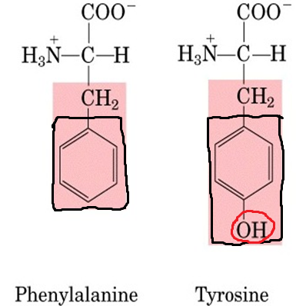
AROMATIC AMINO ACID
Tyrosine is conditional amino acid
Phenylalanie is essential amino acid

Slide 49
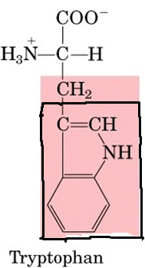
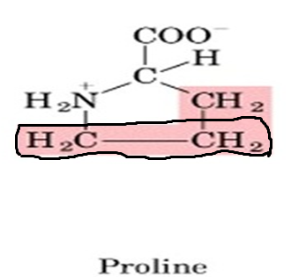
HETEROCYCLIC AMINO ACIDS
Essential amino acid
Conditional amino acid
Indole ring

Slide 50
QUIZ

Slide 51
Q. 1
___________ is a simple amino acid
Glycine
Tryptophan
Proline
None of the above

Slide 52
Q.2
__________ is acidic amino acid
Histidine
Arginine
Lysine
Aspartate

Slide 53
Q.3
61% of skeletal muscles consists of _____
Glutamine
Glutamic acid
Glycine
Glutathione

Slide 54
Q.4
Amino acid possessing guanidinium group is_________
Arginine
Histidine
Lysine
Proline

Slide 55
Q.5
Amino acid possessing indole group is____
Phenylalanine
Tyrosine
Tryptophan
Proline

Slide 56
CLASSIFICATION BASED ON POLARITY
AMINO
ACIDS
NON POLAR
R GROUPS
POLAR RGROUPS
POSITIVELY CHARGED R GROUP
NEGATIVELY CHARGED R GROUP

Slide 57
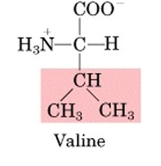
AMINO ACIDS WITH NON POLAR R GROUPS

Slide 58
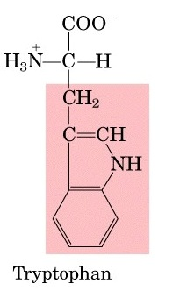
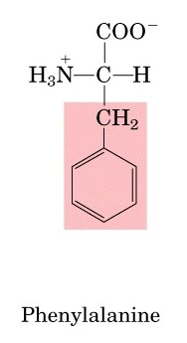
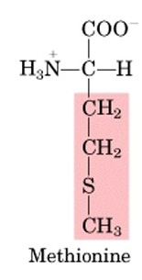
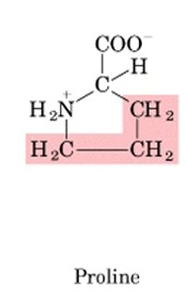
AMINO ACIDS WITH NON POLAR
R GROUPS

Slide 59
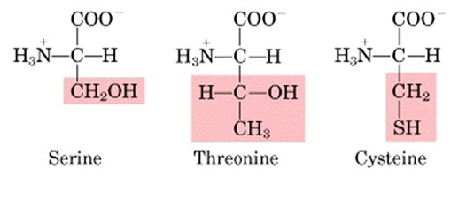
AMINO ACIDS WITH POLAR BUT UNCHARGED R GROUPS

Slide 60
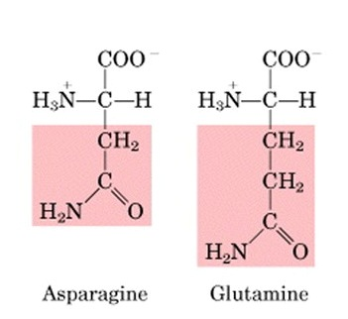
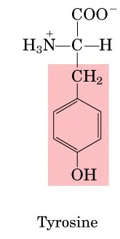
AMINO ACIDS WITH POLAR BUT UNCHARGED R GROUPS

Slide 61
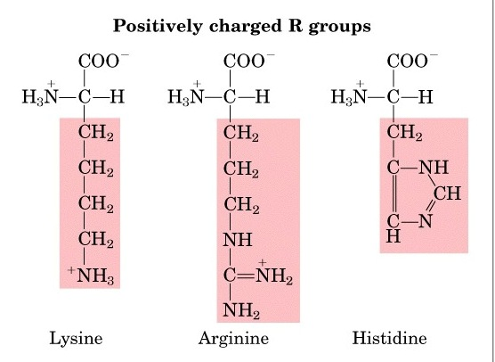

Slide 62
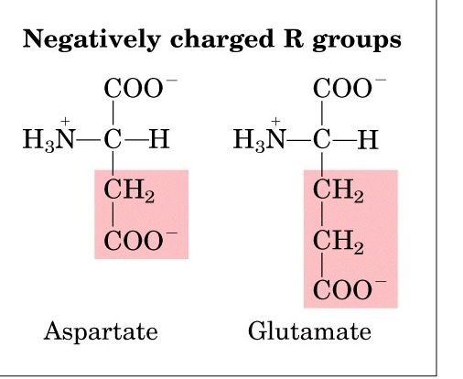

Slide 63
BASED ON NUTRITIONAL REQUIREMENTS
AMINO ACIDS
ESSENTIAL
NON ESSENTIAL
CONDITIONALLY ESSENTIAL

Slide 64
ESSENTIAL AMINO ACIDS
Amino acids that cannot be synthesized by the body and hence needs to be included in diet.
Histidine | Isoleucine | Leucine | Lysine | Methionine
Phenylalanine | Threonine | Tryptophan | Valine

Slide 65
NON ESSENTIAL AMINO ACIDS
Generally, these amino acids are considered non-essential because they can be synthesized from other amino acids.
Alanine | Asparagine | Aspartic acid
Cysteine | Glutamic acid

Slide 66
CONDITIONALLY ESSENTIAL AMINO ACIDS
Usually not required in the diet
Some individuals do not synthesize some of these amino acids in sufficient amounts

Slide 67
CONDITIONALLY ESSENTIAL AMINO ACIDS
Arginine | Cysteine | Glutamine | Glycine
Proline | Serine | Tyrosine

Slide 68
NON STANDARD AMINO ACIDS
Occurs naturally in cells
Do not participate in peptide synthesis
Generated by modification of standard amino acids in peptide molecule
Examples:
Hydroxy lysine
Hydroxy proline
Gama carboxy glutamate

Slide 69
NON PROTEINOGENIC AMINO ACID
Amino acids that are not coded by DNA
Not involved in protein formation
Take part as intermediates in various metabolic cycles
Ornithine
Citrulline

Slide 70
CHEMICAL BONDS IN PROTEIN
PRIMARY
BOND
PEPTIDE
BOND
SECONDARY
BOND
CHEMICAL
BONDS

Slide 71
CHEMICAL BONDS IN PROTEIN
SECONDARY
BOND
DISULPHIDE
BOND
HYDROGEN
BOND
NON POLAR/HYDROPHOBIC
BOND
IONIC
ELECTROSTATIC BOND

Slide 72
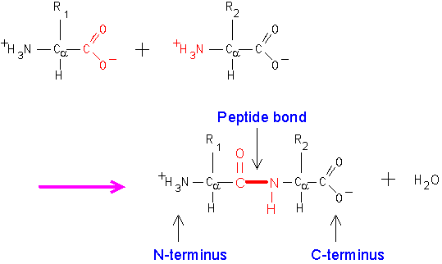
PEPTIDE BOND

Slide 73
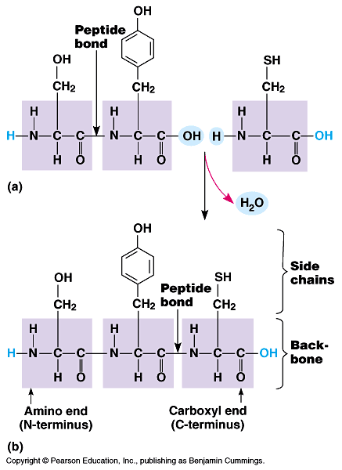

Slide 74
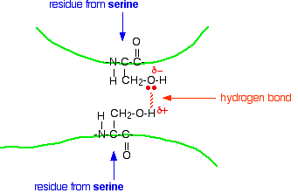
HYDROGEN BOND
Notes:
A weak bond formed between two molecules due to electrostatic attraction between proton in one molecule and electronegative atom in another

Slide 75
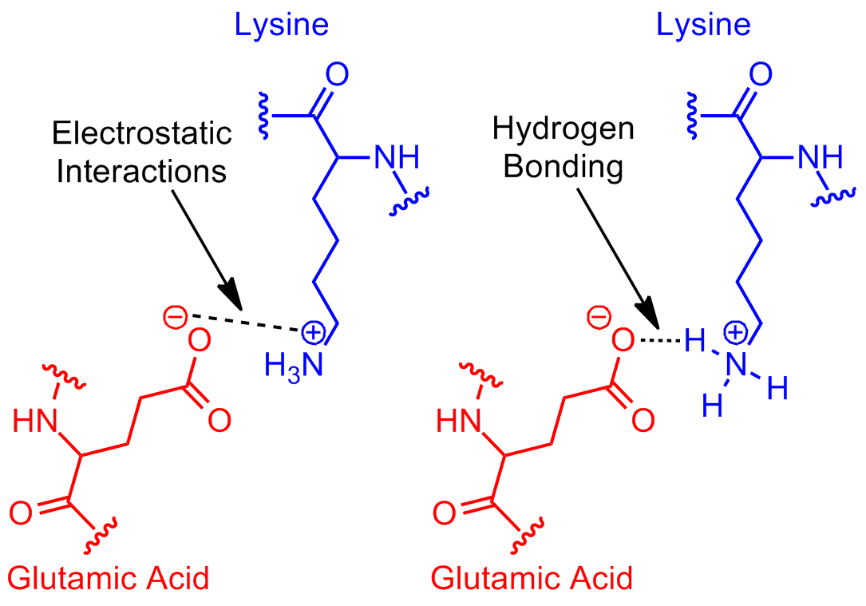

Slide 76
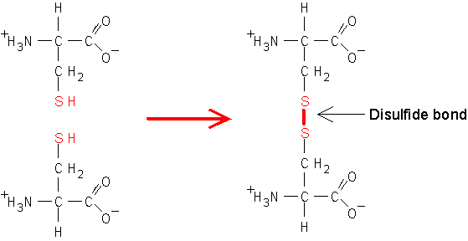

Slide 77
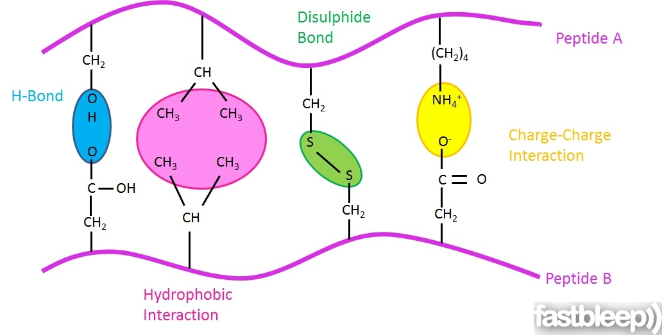
Notes:
Glyl, ala, val, leu, ile, met, pro, phe, trp--- hydrocarbon side chains, because of non polar chemistry

Slide 78
LEVELS OF PROTEIN STRUCTURE
PROTEIN
STRUCTURE
PRIMARY
STRUCTURE
SECONDARY
STRUCTURE
ALPHA HELIX
BETA PLEATED
TERTIARY STRUCTURE
QUATERNARY
STRUCTURE

Slide 79
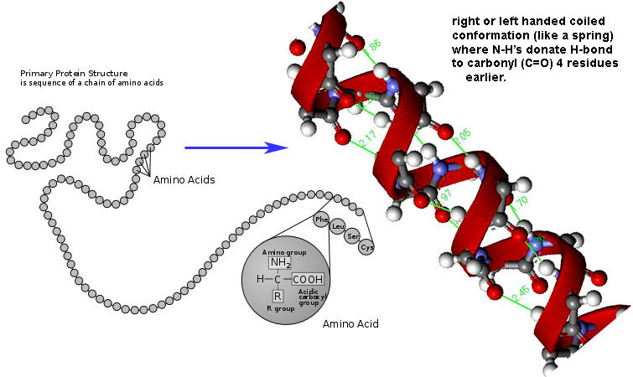
α HELIX STRUCTURE
Notes:
Linus Pauling, 5.4A IN Length and 3.6 amino acid residue, 1.5 A

Slide 80
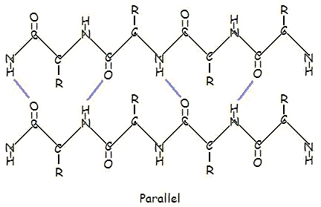
β PLEATED STRUCTURE

Slide 81
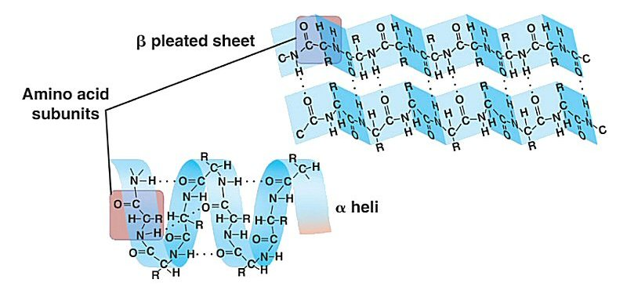
β PLEATED STRUCTURE

Slide 82
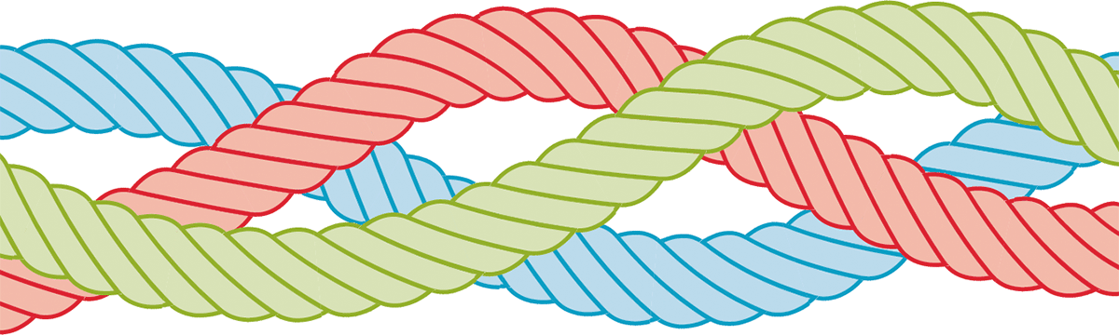
TRIPLE HELIX

Slide 83
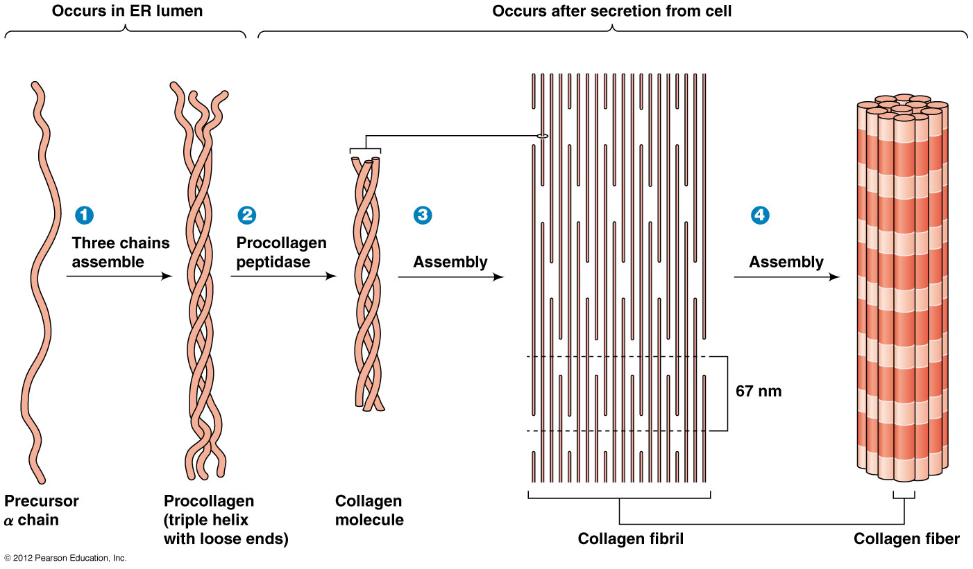
TRIPLE HELIX

Slide 84
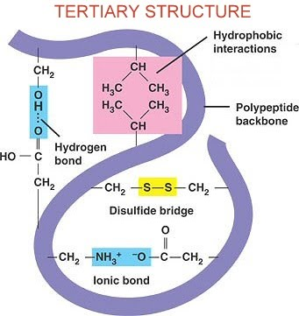

Slide 85
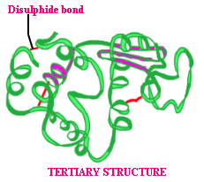

Slide 86
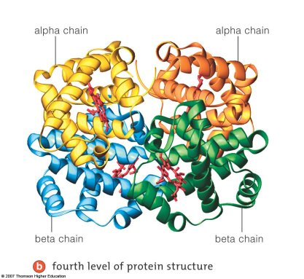
QUATERNARY STRUCTURE

Slide 87
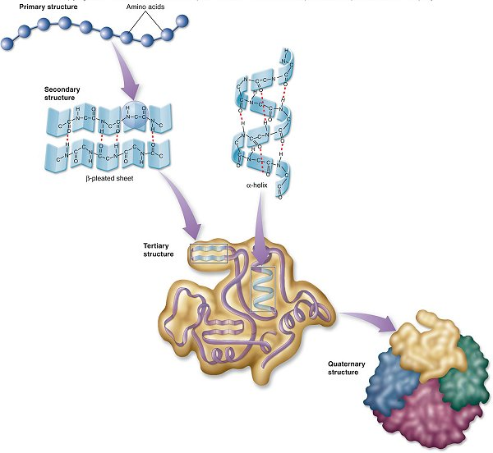

Slide 88


Slide 89
CLASSIFICATION OF PROTEINS
PROTEINS
STRUCTURE
COMPOSITION
SHAPE &SOLUBILITY
FUNCTION
NUTRITIONAL
BASIS

Slide 90
BASED ON STRUCTURE
PROTEINS
FIBROUS
GLOBULAR
INTERMEDIATE

Slide 91
PROTEIN CLASSIFICATIONBASED ON STRUCTURE
 | FIBROUS | GLOBULAR | INTERMEDIATE
SHAPE | Linear | Spherical or globular | Between fibrous& globular
SOLUBILITY | Insoluble | Soluble | Soluble
FUNCTION | Structural | Enzymes, Antibodies, Hormones | Blood clotting proteins
EXAMPLE | Keratin, Silk, Collagen, Myosin | Insulin, Haemoglobin, Polymerase | Fibrinogen

Slide 92
BASED ON FUNCTION
PROTEINS
TRANSPORT
STORAGE
RESPIRATORY
PIGMENTS
CONTRACTILE
HORMONES
TOXINS
STRUCTURAL
ENZYMES

Slide 93


Slide 94
BIOLOGICAL ROLE OF PROTEINS
ENZYMES
FIBROUS PROTEINS
NUCLEOPROTEINS
TRANSPORT PROTEINS
VENOMS
PLASMA PROTEINS
INTERFERONS
DEFENSINS
ENDORPHINS

